Slide 1



Memory Systems Fundamentals, Recent Research, Challenges, Opportunities Lecture 5: Emerging Memory Technologies
Prof. Onur Mutlu
omutlu@gmail.com
https://people.inf.ethz.ch/omutlu
9 October 2018
Technion Fast Course 2018

Slide 2
Emerging Memory Technologies

Slide 3
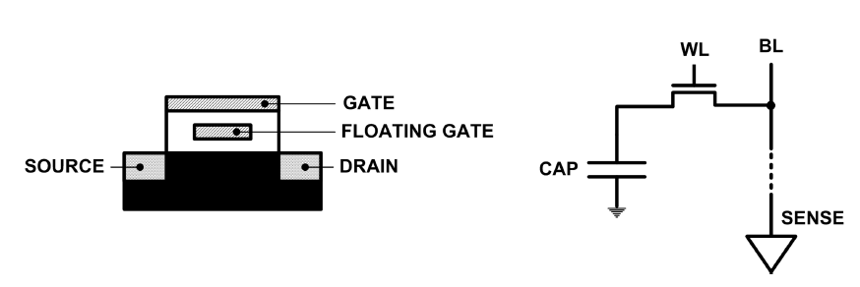
Limits of Charge Memory
Difficult charge placement and control
Flash: floating gate charge
DRAM: capacitor charge, transistor leakage
Reliable sensing becomes difficult as charge storage unit size reduces

Slide 4
Solution 1: New Memory Architectures
Overcome memory shortcomings with
Memory-centric system design
Novel memory architectures, interfaces, functions
Better waste management (efficient utilization)
Key issues to tackle
Enable reliability at low cost → high capacity
Reduce energy
Reduce latency
Improve bandwidth
Reduce waste (capacity, bandwidth, latency)
Enable computation close to data

Slide 5
Solution 1: New Memory Architectures
Liu+, “RAIDR: Retention-Aware Intelligent DRAM Refresh,” ISCA 2012.
Kim+, “A Case for Exploiting Subarray-Level Parallelism in DRAM,” ISCA 2012.
Lee+, “Tiered-Latency DRAM: A Low Latency and Low Cost DRAM Architecture,” HPCA 2013.
Liu+, “An Experimental Study of Data Retention Behavior in Modern DRAM Devices,” ISCA 2013.
Seshadri+, “RowClone: Fast and Efficient In-DRAM Copy and Initialization of Bulk Data,” MICRO 2013.
Pekhimenko+, “Linearly Compressed Pages: A Main Memory Compression Framework,” MICRO 2013.
Chang+, “Improving DRAM Performance by Parallelizing Refreshes with Accesses,” HPCA 2014.
Khan+, “The Efficacy of Error Mitigation Techniques for DRAM Retention Failures: A Comparative Experimental Study,” SIGMETRICS 2014.
Luo+, “Characterizing Application Memory Error Vulnerability to Optimize Data Center Cost,” DSN 2014.
Kim+, “Flipping Bits in Memory Without Accessing Them: An Experimental Study of DRAM Disturbance Errors,” ISCA 2014.
Lee+, “Adaptive-Latency DRAM: Optimizing DRAM Timing for the Common-Case,” HPCA 2015.
Qureshi+, “AVATAR: A Variable-Retention-Time (VRT) Aware Refresh for DRAM Systems,” DSN 2015.
Meza+, “Revisiting Memory Errors in Large-Scale Production Data Centers: Analysis and Modeling of New Trends from the Field,” DSN 2015.
Kim+, “Ramulator: A Fast and Extensible DRAM Simulator,” IEEE CAL 2015.
Seshadri+, “Fast Bulk Bitwise AND and OR in DRAM,” IEEE CAL 2015.
Ahn+, “A Scalable Processing-in-Memory Accelerator for Parallel Graph Processing,” ISCA 2015.
Ahn+, “PIM-Enabled Instructions: A Low-Overhead, Locality-Aware Processing-in-Memory Architecture,” ISCA 2015.
Lee+, “Decoupled Direct Memory Access: Isolating CPU and IO Traffic by Leveraging a Dual-Data-Port DRAM,” PACT 2015.
Seshadri+, “Gather-Scatter DRAM: In-DRAM Address Translation to Improve the Spatial Locality of Non-unit Strided Accesses,” MICRO 2015.
Lee+, “Simultaneous Multi-Layer Access: Improving 3D-Stacked Memory Bandwidth at Low Cost,” TACO 2016.
Hassan+, “ChargeCache: Reducing DRAM Latency by Exploiting Row Access Locality,” HPCA 2016.
Chang+, “Low-Cost Inter-Linked Subarrays (LISA): Enabling Fast Inter-Subarray Data Migration in DRAM,” HPCA 2016.
Chang+, “Understanding Latency Variation in Modern DRAM Chips Experimental Characterization, Analysis, and Optimization,” SIGMETRICS 2016.
Khan+, “PARBOR: An Efficient System-Level Technique to Detect Data Dependent Failures in DRAM,” DSN 2016.
Hsieh+, “Transparent Offloading and Mapping (TOM): Enabling Programmer-Transparent Near-Data Processing in GPU Systems,” ISCA 2016.
Hashemi+, “Accelerating Dependent Cache Misses with an Enhanced Memory Controller,” ISCA 2016.
Boroumand+, “LazyPIM: An Efficient Cache Coherence Mechanism for Processing-in-Memory,” IEEE CAL 2016.
Pattnaik+, “Scheduling Techniques for GPU Architectures with Processing-In-Memory Capabilities,” PACT 2016.
Hsieh+, “Accelerating Pointer Chasing in 3D-Stacked Memory: Challenges, Mechanisms, Evaluation,” ICCD 2016.
Hashemi+, “Continuous Runahead: Transparent Hardware Acceleration for Memory Intensive Workloads,” MICRO 2016.
Khan+, “A Case for Memory Content-Based Detection and Mitigation of Data-Dependent Failures in DRAM",” IEEE CAL 2016.
Hassan+, “SoftMC: A Flexible and Practical Open-Source Infrastructure for Enabling Experimental DRAM Studies,” HPCA 2017.
Mutlu, “The RowHammer Problem and Other Issues We May Face as Memory Becomes Denser,” DATE 2017.
Lee+, “Design-Induced Latency Variation in Modern DRAM Chips: Characterization, Analysis, and Latency Reduction Mechanisms,” SIGMETRICS 2017.
Chang+, “Understanding Reduced-Voltage Operation in Modern DRAM Devices: Experimental Characterization, Analysis, and Mechanisms,” SIGMETRICS 2017.
Patel+, “The Reach Profiler (REAPER): Enabling the Mitigation of DRAM Retention Failures via Profiling at Aggressive Conditions,” ISCA 2017.
Seshadri and Mutlu, “Simple Operations in Memory to Reduce Data Movement,” ADCOM 2017.
Liu+, “Concurrent Data Structures for Near-Memory Computing,” SPAA 2017.
Khan+, “Detecting and Mitigating Data-Dependent DRAM Failures by Exploiting Current Memory Content,” MICRO 2017.
Seshadri+, “Ambit: In-Memory Accelerator for Bulk Bitwise Operations Using Commodity DRAM Technology,” MICRO 2017.
Kim+, “GRIM-Filter: Fast Seed Location Filtering in DNA Read Mapping Using Processing-in-Memory Technologies,” BMC Genomics 2018.
Kim+, “The DRAM Latency PUF: Quickly Evaluating Physical Unclonable Functions by Exploiting the Latency-Reliability Tradeoff in Modern DRAM Devices,” HPCA 2018.
Boroumand+, “Google Workloads for Consumer Devices: Mitigating Data Movement Bottlenecks,” ASPLOS 2018.
Das+, “VRL-DRAM: Improving DRAM Performance via Variable Refresh Latency,” DAC 2018.
Ghose+, “What Your DRAM Power Models Are Not Telling You: Lessons from a Detailed Experimental Study,” SIGMETRICS 2018.
Kim+, “Solar-DRAM: Reducing DRAM Access Latency by Exploiting the Variation in Local Bitlines,” ICCD 2018.
Wang+, “Reducing DRAM Latency via Charge-Level-Aware Look-Ahead Partial Restoration,” MICRO 2018.
Avoid DRAM:
Seshadri+, “The Evicted-Address Filter: A Unified Mechanism to Address Both Cache Pollution and Thrashing,” PACT 2012.
Pekhimenko+, “Base-Delta-Immediate Compression: Practical Data Compression for On-Chip Caches,” PACT 2012.
Seshadri+, “The Dirty-Block Index,” ISCA 2014.
Pekhimenko+, “Exploiting Compressed Block Size as an Indicator of Future Reuse,” HPCA 2015.
Vijaykumar+, “A Case for Core-Assisted Bottleneck Acceleration in GPUs: Enabling Flexible Data Compression with Assist Warps,” ISCA 2015.
Pekhimenko+, “Toggle-Aware Bandwidth Compression for GPUs,” HPCA 2016.

Slide 6
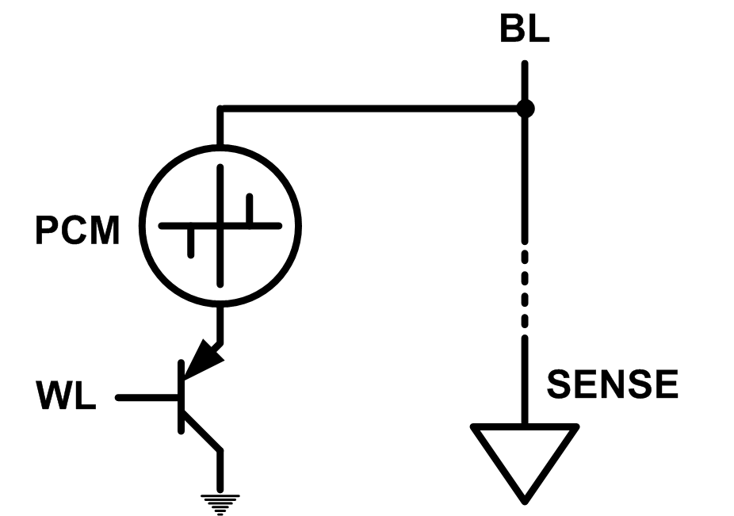
Solution 2: Emerging Memory Technologies
Some emerging resistive memory technologies seem more scalable than DRAM (and they are non-volatile)
Example: Phase Change Memory
Data stored by changing phase of material
Data read by detecting material’s resistance
Expected to scale to 9nm (2022 [ITRS 2009])
Prototyped at 20nm (Raoux+, IBM JRD 2008)
Expected to be denser than DRAM: can store multiple bits/cell
But, emerging technologies have (many) shortcomings
Can they be enabled to replace/augment/surpass DRAM?
Notes:
Even if DRAM continues to scale there could be benefits to examining and enabling these new technologies.

Slide 7
Solution 2: Emerging Memory Technologies
Lee+, “Architecting Phase Change Memory as a Scalable DRAM Alternative,” ISCA’09, CACM’10, IEEE Micro’10.
Meza+, “Enabling Efficient and Scalable Hybrid Memories,” IEEE Comp. Arch. Letters 2012.
Yoon, Meza+, “Row Buffer Locality Aware Caching Policies for Hybrid Memories,” ICCD 2012.
Kultursay+, “Evaluating STT-RAM as an Energy-Efficient Main Memory Alternative,” ISPASS 2013.
Meza+, “A Case for Efficient Hardware-Software Cooperative Management of Storage and Memory,” WEED 2013.
Lu+, “Loose Ordering Consistency for Persistent Memory,” ICCD 2014.
Zhao+, “FIRM: Fair and High-Performance Memory Control for Persistent Memory Systems,” MICRO 2014.
Yoon, Meza+, “Efficient Data Mapping and Buffering Techniques for Multi-Level Cell Phase-Change Memories,” TACO 2014.
Ren+, “ThyNVM: Enabling Software-Transparent Crash Consistency in Persistent Memory Systems,” MICRO 2015.
Chauhan+, “NVMove: Helping Programmers Move to Byte-Based Persistence,” INFLOW 2016.
Li+, “Utility-Based Hybrid Memory Management,” CLUSTER 2017.
Yu+, “Banshee: Bandwidth-Efficient DRAM Caching via Software/Hardware Cooperation,” MICRO 2017.
Tavakkol+, “MQSim: A Framework for Enabling Realistic Studies of Modern Multi-Queue SSD Devices,” FAST 2018.
Tavakkol+, “FLIN: Enabling Fairness and Enhancing Performance in Modern NVMe Solid State Drives,” ISCA 2018.
Sadrosadati+. “LTRF: Enabling High-Capacity Register Files for GPUs via Hardware/Software Cooperative Register Prefetching,” ASPLOS 2018.
Notes:
Even if DRAM continues to scale there could be benefits to examining and enabling these new technologies.

Slide 8
Charge vs. Resistive Memories
Charge Memory (e.g., DRAM, Flash)
Write data by capturing charge Q
Read data by detecting voltage V
Resistive Memory (e.g., PCM, STT-MRAM, memristors)
Write data by pulsing current dQ/dt
Read data by detecting resistance R

Slide 9
Promising Resistive Memory Technologies
PCM
Inject current to change material phase
Resistance determined by phase
STT-MRAM
Inject current to change magnet polarity
Resistance determined by polarity
Memristors/RRAM/ReRAM
Inject current to change atomic structure
Resistance determined by atom distance

Slide 10
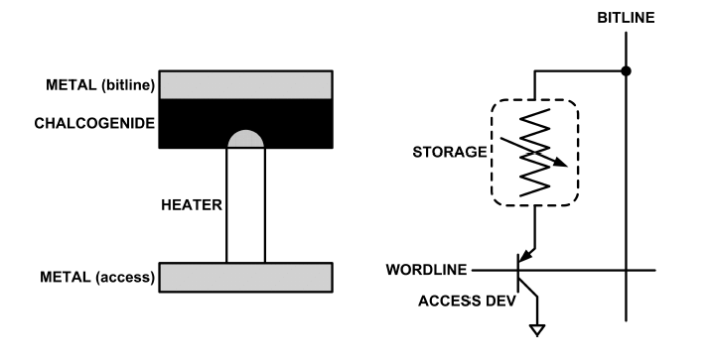
What is Phase Change Memory?
Phase change material (chalcogenide glass) exists in two states:
Amorphous: Low optical reflexivity and high electrical resistivity
Crystalline: High optical reflexivity and low electrical resistivity
PCM is resistive memory: High resistance (0), Low resistance (1)
PCM cell can be switched between states reliably and quickly

Slide 11
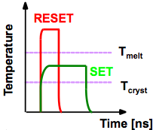
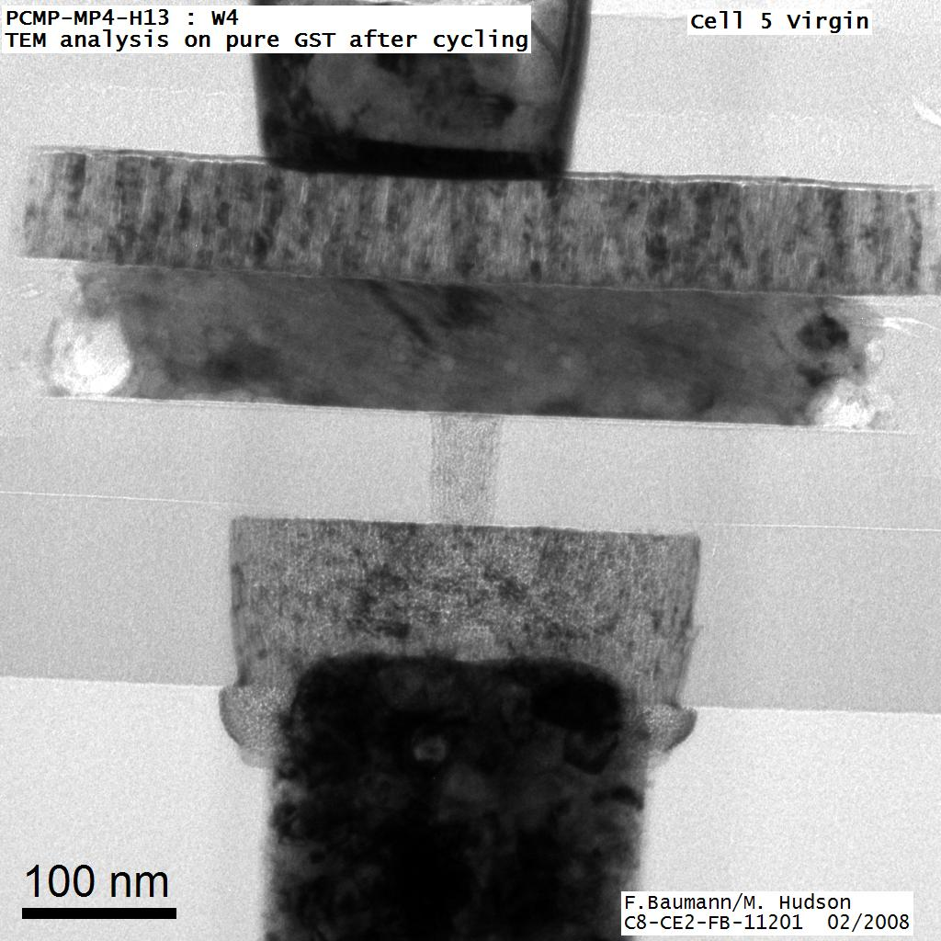
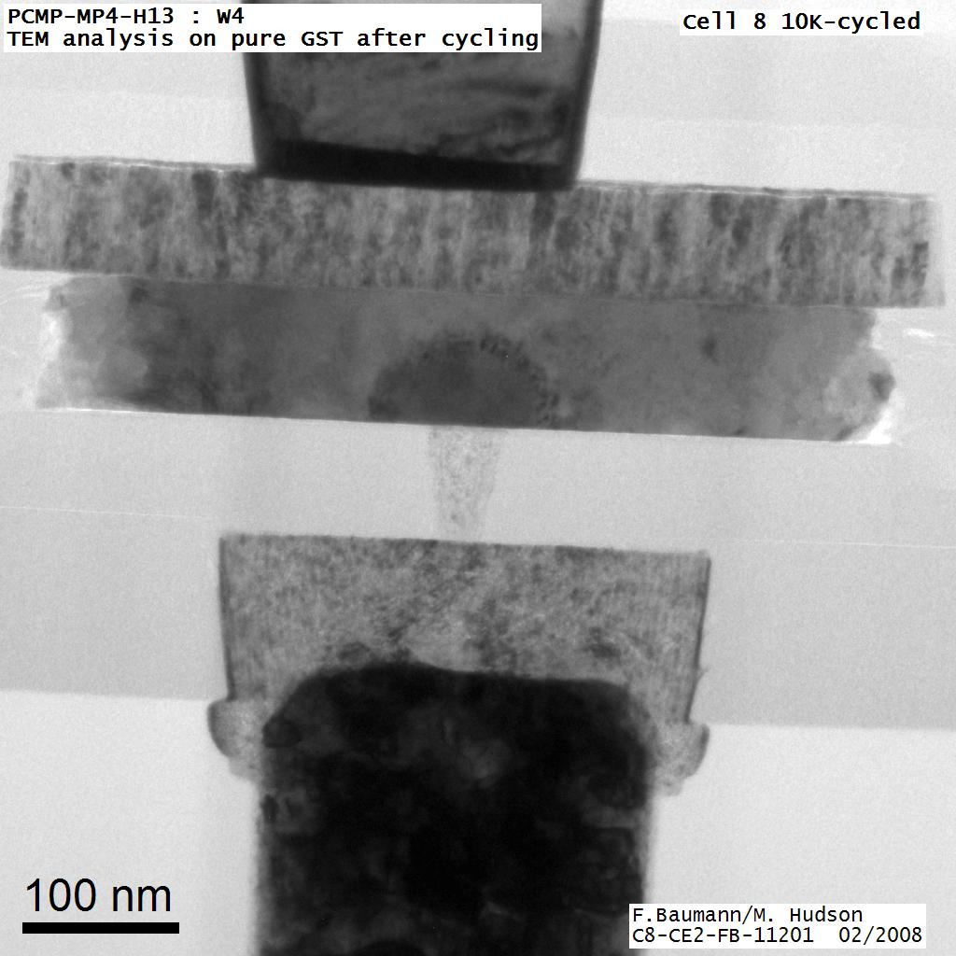
How Does PCM Work?
Write: change phase via current injection
SET: sustained current to heat cell above Tcryst
RESET: cell heated above Tmelt and quenched
Read: detect phase via material resistance
amorphous/crystalline
Large
Current
Small
Current
Memory
Element
SET (cryst)
Low resistance
Access
Device
RESET (amorph)
High resistance
10³-10⁴ Ω
10⁶-10⁷ Ω
Photo Courtesy: Bipin Rajendran, IBM
Slide Courtesy: Moinuddin Qureshi, IBM

Slide 12
Opportunity: PCM Advantages
Scales better than DRAM, Flash
Requires current pulses, which scale linearly with feature size
Expected to scale to 9nm (2022 [ITRS])
Prototyped at 20nm (Raoux+, IBM JRD 2008)
Can be denser than DRAM
Can store multiple bits per cell due to large resistance range
Prototypes with 2 bits/cell in ISSCC’08, 4 bits/cell by 2012
Non-volatile
Retain data for >10 years at 85C
No refresh needed, low idle power

Slide 13
PCM Resistance → Value
1
0
Cell value:
Cell resistance

Slide 14
Multi-Level Cell PCM
Multi-level cell: more than 1 bit per cell
Further increases density by 2 to 4x [Lee+,ISCA'09]
But MLC-PCM also has drawbacks
Higher latency and energy than single-level cell PCM

Slide 15
MLC-PCM Resistance → Value
Bit 1
Bit 0
1
1
1
0
0
1
0
0
Cell value:
Cell resistance

Slide 16
MLC-PCM Resistance → Value
Less margin between values
→ need more precise sensing/modification of cell contents
→ higher latency/energy (~2x for reads and 4x for writes)
1
1
1
0
0
1
0
0
Cell value:
Cell resistance

Slide 17
Phase Change Memory Properties
Surveyed prototypes from 2003-2008 (ITRS, IEDM, VLSI, ISSCC)
Derived PCM parameters for F=90nm
Lee, Ipek, Mutlu, Burger, “Architecting Phase Change Memory as a Scalable DRAM Alternative,” ISCA 2009.
Lee et al., “Phase Change Technology and the Future of Main Memory,” IEEE Micro Top Picks 2010.

Slide 18
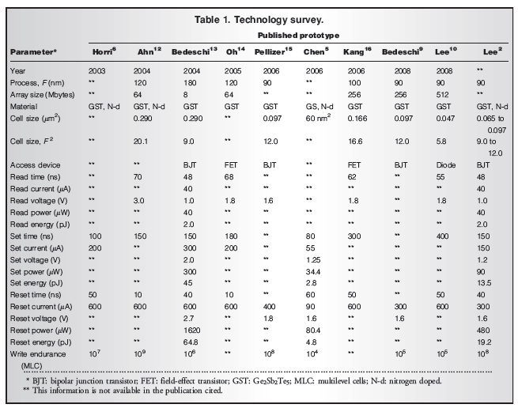

Slide 19
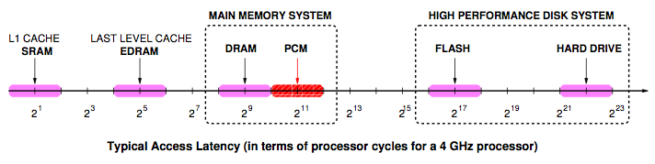
Phase Change Memory Properties: Latency
Latency comparable to, but slower than DRAM
Read Latency
50ns: 4x DRAM, 10⁻³x NAND Flash
Write Latency
150ns: 12x DRAM
Write Bandwidth
5-10 MB/s: 0.1x DRAM, 1x NAND Flash
Qureshi+, “Scalable high performance main memory system using phase-change memory technology,” ISCA 2009.

Slide 20
Phase Change Memory Properties
Dynamic Energy
40 uA Rd, 150 uA Wr
2-43x DRAM, 1x NAND Flash
Endurance
Writes induce phase change at 650C
Contacts degrade from thermal expansion/contraction
10⁸ writes per cell
10⁻⁸x DRAM, 10³x NAND Flash
Cell Size
9-12F² using BJT, single-level cells
1.5x DRAM, 2-3x NAND (will scale with feature size, MLC)

Slide 21
Phase Change Memory: Pros and Cons
Pros over DRAM
Better technology scaling (capacity and cost)
Non volatile → Persistent
Low idle power (no refresh)
Cons
Higher latencies: ~4-15x DRAM (especially write)
Higher active energy: ~2-50x DRAM (especially write)
Lower endurance (a cell dies after ~10⁸ writes)
Reliability issues (resistance drift)
Challenges in enabling PCM as DRAM replacement/helper:
Mitigate PCM shortcomings
Find the right way to place PCM in the system

Slide 22
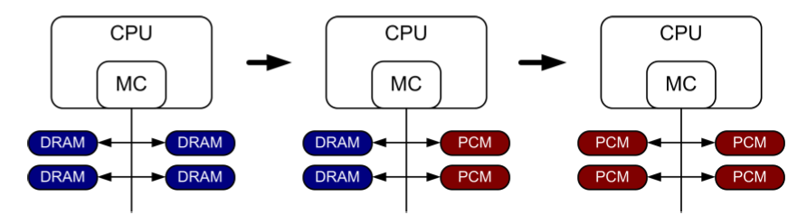
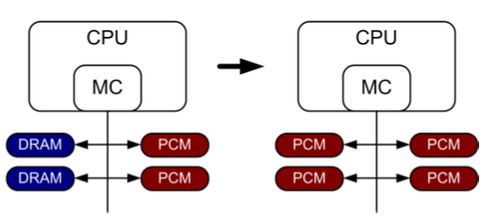
PCM-based Main Memory (I)
How should PCM-based (main) memory be organized?
Hybrid PCM+DRAM [Qureshi+ ISCA’09, Dhiman+ DAC’09]:
How to partition/migrate data between PCM and DRAM

Slide 23
PCM-based Main Memory (II)
How should PCM-based (main) memory be organized?
Pure PCM main memory [Lee et al., ISCA’09, Top Picks’10]:
How to redesign entire hierarchy (and cores) to overcome PCM shortcomings

Slide 24
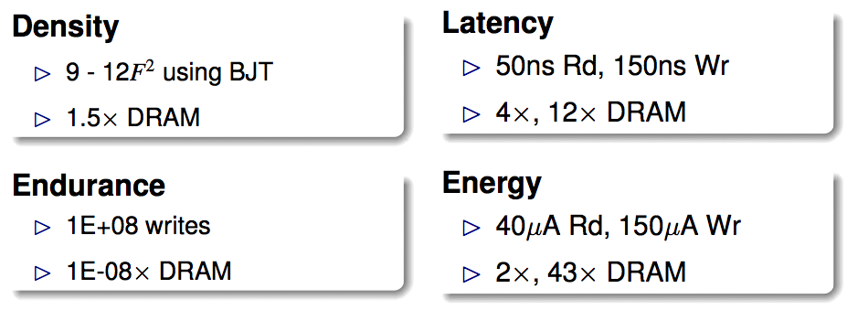
An Initial Study: Replace DRAM with PCM
Lee, Ipek, Mutlu, Burger, “Architecting Phase Change Memory as a Scalable DRAM Alternative,” ISCA 2009.
Surveyed prototypes from 2003-2008 (e.g. IEDM, VLSI, ISSCC)
Derived “average” PCM parameters for F=90nm

Slide 25
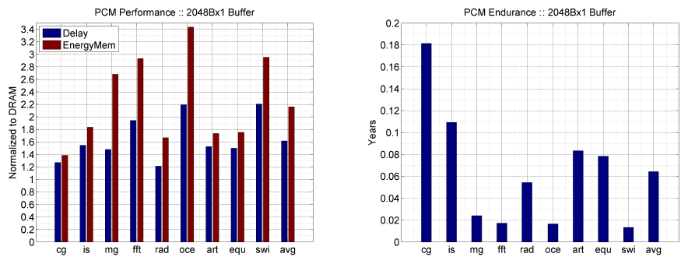
Results: Naïve Replacement of DRAM with PCM
Replace DRAM with PCM in a 4-core, 4MB L2 system
PCM organized the same as DRAM: row buffers, banks, peripherals
1.6x delay, 2.2x energy, 500-hour average lifetime
Lee, Ipek, Mutlu, Burger, “Architecting Phase Change Memory as a Scalable DRAM Alternative,” ISCA 2009.

Slide 26
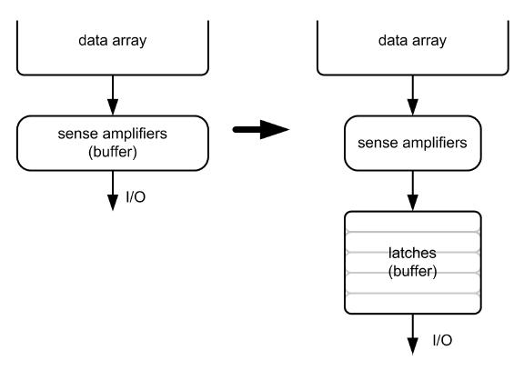
Architecting PCM to Mitigate Shortcomings
Idea 1: Use multiple narrow row buffers in each PCM chip
→ Reduces array reads/writes → better endurance, latency, energy
Idea 2: Write into array at
cache block or word
granularity
→ Reduces unnecessary wear
DRAM
PCM

Slide 27
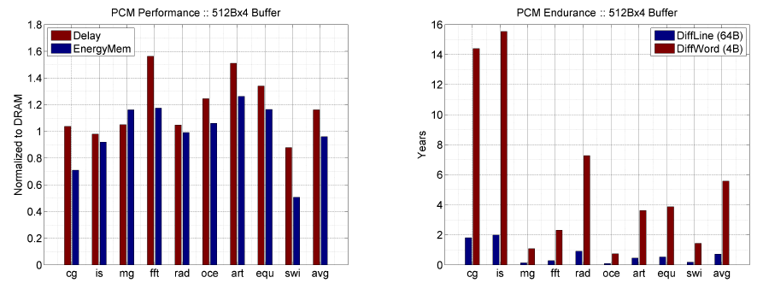
Results: Architected PCM as Main Memory
1.2x delay, 1.0x energy, 5.6-year average lifetime
Scaling improves energy, endurance, density
Caveat 1: Worst-case lifetime is much shorter (no guarantees)
Caveat 2: Intensive applications see large performance and energy hits
Caveat 3: Optimistic PCM parameters?

Slide 28
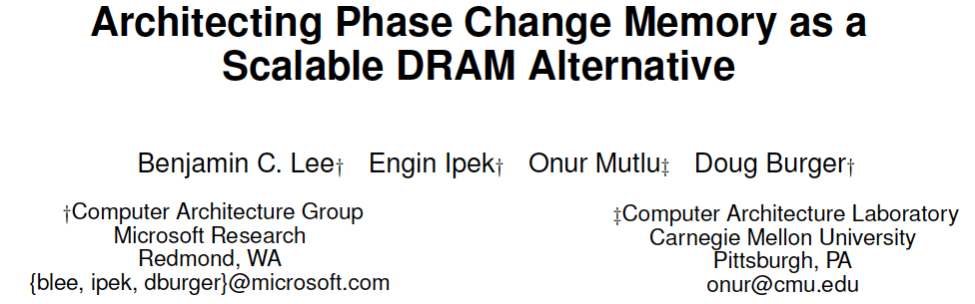
Required Reading: PCM As Main Memory
Benjamin C. Lee, Engin Ipek, Onur Mutlu, and Doug Burger, "Architecting Phase Change Memory as a Scalable DRAM Alternative" Proceedings of the 36th International Symposium on Computer Architecture (ISCA), pages 2-13, Austin, TX, June 2009. Slides (pdf)

Slide 29
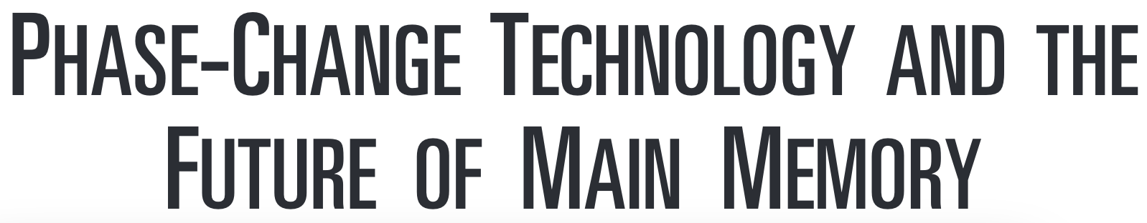
More on PCM As Main Memory (II)
Benjamin C. Lee, Ping Zhou, Jun Yang, Youtao Zhang, Bo Zhao, Engin Ipek, Onur Mutlu, and Doug Burger, "Phase Change Technology and the Future of Main Memory" IEEE Micro, Special Issue: Micro's Top Picks from 2009 Computer Architecture Conferences (MICRO TOP PICKS), Vol. 30, No. 1, pages 60-70, January/February 2010.

Slide 30
STT-MRAM as Main Memory
Magnetic Tunnel Junction (MTJ) device
Reference layer: Fixed magnetic orientation
Free layer: Parallel or anti-parallel
Magnetic orientation of the free layer determines logical state of device
High vs. low resistance
Write: Push large current through MTJ to change orientation of free layer
Read: Sense current flow
Kultursay et al., “Evaluating STT-RAM as an Energy-Efficient Main Memory Alternative,” ISPASS 2013.
Logical 0
Reference Layer
Barrier
Free Layer
Logical 1
Reference Layer
Barrier
Free Layer
Word Line
MTJ
Access
Transistor
Bit Line
Sense Line
Notes:
Moving from DRAM to STT-RAM, instead of a capacitor that stores charge, now we have a magnetic tunnel junction that has one reference layer with a fixed magnetic orientation, and a free layer that can be parallel or anti parallel to the reference layer; which determines the resistance, and in turn, the data stored in the MTJ. In addition to the MTJ, the cell, again, has an access transistor.
Reading requires a small voltage to be applied across the bitline and sense line; and the current is sensed. This current varies depending on the resistance of MTJ. To write data, we push a large current into the MTJ, which re-aligns the free layer. The direction of the current determines whether it becomes parallel or anti-parallel; i.e. logical 0 or 1.

Slide 31
STT-MRAM: Pros and Cons
Pros over DRAM
Better technology scaling (capacity and cost)
Non volatile → Persistent
Low idle power (no refresh)
Cons
Higher write latency
Higher write energy
Poor density (currently)
Reliability?
Another level of freedom
Can trade off non-volatility for lower write latency/energy (by reducing the size of the MTJ)

Slide 32
Architected STT-MRAM as Main Memory
4-core, 4GB main memory, multiprogrammed workloads
~6% performance loss, ~60% energy savings vs. DRAM
Kultursay+, “Evaluating STT-RAM as an Energy-Efficient Main Memory Alternative,” ISPASS 2013.

Slide 33

More on STT-MRAM as Main Memory
Emre Kultursay, Mahmut Kandemir, Anand Sivasubramaniam, and Onur Mutlu, "Evaluating STT-RAM as an Energy-Efficient Main Memory Alternative" Proceedings of the 2013 IEEE International Symposium on Performance Analysis of Systems and Software (ISPASS), Austin, TX, April 2013. Slides (pptx) (pdf)

Slide 34
A More Viable Approach: Hybrid Memory Systems
CPU
Meza+, “Enabling Efficient and Scalable Hybrid Memories,” IEEE Comp. Arch. Letters, 2012.
Yoon+, “Row Buffer Locality Aware Caching Policies for Hybrid Memories,” ICCD 2012 Best Paper Award.
DRAMCtrl
PCM Ctrl
DRAM
Phase Change Memory (or Tech. X)
Fast, durable
Small,
leaky, volatile,
high-cost
Large, non-volatile, low-cost
Slow, wears out, high active energy
Hardware/software manage data allocation and movement
to achieve the best of multiple technologies

Slide 35
Challenge and Opportunity
Providing the Best of
Multiple Metrics
with
Multiple Memory Technologies

Slide 36
Challenge and Opportunity
Heterogeneous,
Configurable,
Programmable
Memory Systems

Slide 37
Hybrid Memory Systems: Issues
Cache vs. Main Memory
Granularity of Data Move/Manage-ment: Fine or Coarse
Hardware vs. Software vs. HW/SW Cooperative
When to migrate data?
How to design a scalable and efficient large cache?
…

Slide 38
One Option: DRAM as a Cache for PCM
PCM is main memory; DRAM caches memory rows/blocks
Benefits: Reduced latency on DRAM cache hit; write filtering
Memory controller hardware manages the DRAM cache
Benefit: Eliminates system software overhead
Three issues:
What data should be placed in DRAM versus kept in PCM?
What is the granularity of data movement?
How to design a low-cost hardware-managed DRAM cache?
Two idea directions:
Locality-aware data placement [Yoon+ , ICCD 2012]
Cheap tag stores and dynamic granularity [Meza+, IEEE CAL 2012]

Slide 39
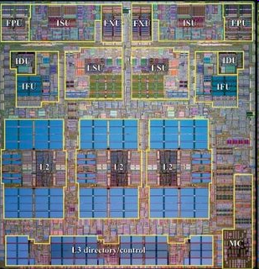
DRAM as a Cache for PCM
Goal: Achieve the best of both DRAM and PCM/NVM
Minimize amount of DRAM w/o sacrificing performance, endurance
DRAM as cache to tolerate PCM latency and write bandwidth
PCM as main memory to provide large capacity at good cost and power
PCM Main Memory
DATA
Processor
DRAM Buffer
T
DATA
Flash
Or
HDD
T=Tag-Store
PCM Write Queue
Qureshi+, “Scalable high performance main memory system using phase-change memory technology,” ISCA 2009.

Slide 40
Write Filtering Techniques
Lazy Write: Pages from disk installed only in DRAM, not PCM
Partial Writes: Only dirty lines from DRAM page written back
Page Bypass: Discard pages with poor reuse on DRAM eviction
Qureshi et al., “Scalable high performance main memory system using phase-change memory technology,” ISCA 2009.
PCM Main Memory
DATA
Processor
DRAM Buffer
T
DATA
Flash
Or
HDD

Slide 41
Results: DRAM as PCM Cache (I)
Simulation of 16-core system, 8GB DRAM main-memory at 320 cycles, HDD (2 ms) with Flash (32 us) with Flash hit-rate of 99%
Assumption: PCM 4x denser, 4x slower than DRAM
DRAM block size = PCM page size (4kB)
Qureshi+, “Scalable high performance main memory system using phase-change memory technology,” ISCA 2009.
Notes:
Workloads:
Database workloads & Data parallel kernels
1. Database workloads: db1 and db2
2. Unix utilities: qsort and binary search
3. Data Mining : K-means and Gauss Seidal
4. Streaming: DAXPY and Vector Dot Product

Slide 42
Results: DRAM as PCM Cache (II)
PCM-DRAM Hybrid performs similarly to similar-size DRAM
Significant energy savings with PCM-DRAM Hybrid
Average lifetime: 9.7 years (no guarantees)
Qureshi+, “Scalable high performance main memory system using phase-change memory technology,” ISCA 2009.

Slide 43
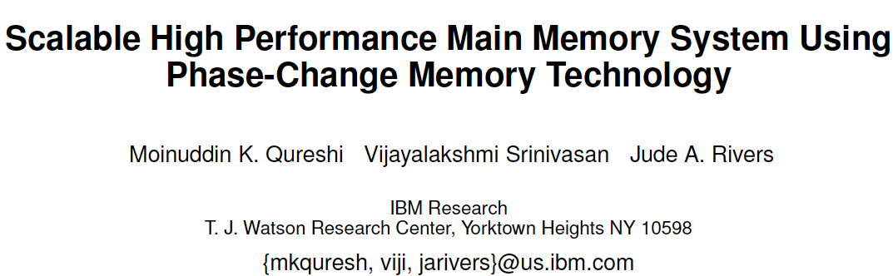
More on DRAM-PCM Hybrid Memory
Scalable High-Performance Main Memory System Using Phase-Change Memory Technology. Moinuddin K. Qureshi, Viji Srinivasan, and Jude A. Rivers Appears in the International Symposium on Computer Architecture (ISCA) 2009.

Slide 44
Data Placement in Hybrid Memory
Cores/Caches
Memory Controllers
Channel A
IDLE
Channel B
Memory A
Memory B
(Fast, Small)
(Large, Slow)
Page 1
Page 2
Which memory do we place each page in,
to maximize system performance?
Memory A is fast, but small
Load should be balanced on both channels?
Page migrations have performance and energy overhead

Slide 45
Data Placement Between DRAM and PCM
Idea: Characterize data access patterns and guide data placement in hybrid memory
Streaming accesses: As fast in PCM as in DRAM
Random accesses: Much faster in DRAM
Idea: Place random access data with some reuse in DRAM; streaming data in PCM
Yoon+, “Row Buffer Locality-Aware Data Placement in Hybrid Memories,” ICCD 2012 Best Paper Award.

Slide 46
Key Observation & Idea
Row buffers exist in both DRAM and PCM
Row hit latency similar in DRAM & PCM [Lee+ ISCA’09]
Row miss latency small in DRAM, large in PCM
Place data in DRAM which
is likely to miss in the row buffer (low row buffer locality)→ miss penalty is smaller in DRAM
AND
is reused many times → cache only the data worth the movement cost and DRAM space
Notes:
Our key observation is that row buffers exist in both DRAM and PCM.
Row hit latency, which does not access the memory cell array, is similar in DRAM and PCM.
It is for a row miss that the memory access latency is small in DRAM and large in PCM.
Therefore we would like to place data in DRAM which:
Is likely to miss in the row buffer, which we call as having low row buffer locality, since the row buffer miss penalty is small in DRAM than it is in PCM.
And we would like to place data in DRAM which is reused many times, so that we cache only the data that is worth the movement cost.

Slide 47
Hybrid vs. All-PCM/DRAM [ICCD’12]
29%
31%
31% better performance than all PCM,
within 29% of all DRAM performance
Yoon+, “Row Buffer Locality-Aware Data Placement in Hybrid Memories,” ICCD 2012 Best Paper Award.
Notes:
Now let’s compare our mechanism to a homogeneous memory system.
Here the comparison points are a 16GB all-PCM and all-DRAM memory system.
Our mechanism achieves 31% better performance than the all-PCM memory system, and comes within 29% of the all-DRAM performance.
Note that we do not assume any capacity benefits of PCM over DRAM.
And yet, our mechanism bridges the performance gap between the two homogeneous memory systems.
If the capacity benefit of PCM was included, the hybrid memory system will perform even better.

Slide 48
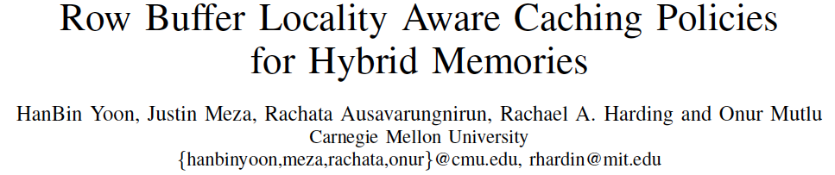
More on Hybrid Memory Data Placement
HanBin Yoon, Justin Meza, Rachata Ausavarungnirun, Rachael Harding, and Onur Mutlu, "Row Buffer Locality Aware Caching Policies for Hybrid Memories" Proceedings of the 30th IEEE International Conference on Computer Design (ICCD), Montreal, Quebec, Canada, September 2012. Slides (pptx) (pdf)

Slide 49
Weaknesses of Existing Solutions
They are all heuristics that consider only a limited part of memory access behavior
Do not directly capture the overall system performance impact of data placement decisions
Example: None capture memory-level parallelism (MLP)
Number of concurrent memory requests from the same application when a page is accessed
Affects how much page migration helps performance
Notes:
These proposals consider only a limited number of characteristics, using these few data points to construct a placement heuristic that is specific to the memory types being used in the system.
These heuristic-based approaches do not directly capture the overall system performance benefits of data placement decisions.
Therefore, they can only indirectly optimize system performance, which sometimes leads to sub-optimal data placement decisions.

Slide 50
Importance of Memory-Level Parallelism
Before migration:
Before migration:
requests to Page 1
Mem. B
requests to Page 2
Mem. B
requests to Page 3
Mem. B
After migration:
After migration:
requests to Page 1
Mem. A
requests to Page 2
Mem. A
T
requests to Page 3
T
Mem. B
Mem. A
time
Migrating one page reduces stall time by T
time
Must migrate two pages to reduce stall time by T:
migrating one page alone does not help
Page migration decisions need to consider MLP
Notes:
Should say: On the left, The page has much more utility because it directly affects performance if it is migrated to the fast memory;
On the right. Each page has less utility because migrated alone, neither would affect performance significantly. They both need to be migrated together.
Let’s look at two pages with access latency overlapped with each other
Change animation later

Slide 51
Our Goal [CLUSTER 2017]
A generalized mechanism that
1. Directly estimates the performance benefit of migrating a page between any two types of memory
2. Places only the performance-critical data in the fast memory

Slide 52
Utility-Based Hybrid Memory Management
A memory manager that works for any hybrid memory
e.g., DRAM-NVM, DRAM-RLDRAM
Key Idea
For each page, use comprehensive characteristics to calculate estimated utility (i.e., performance impact) of migrating page from one memory to the other in the system
Migrate only pages with the highest utility (i.e., pages that improve system performance the most when migrated)
Li+, “Utility-Based Hybrid Memory Management”, CLUSTER 2017.

Slide 53
Key Mechanisms of UH-MEM
For each page, estimate utility using a performance model
Application stall time reduction
How much would migrating a page benefit the performance of the application that the page belongs to?
Application performance sensitivity
How much does the improvement of a single application’s performance increase the overall system performance?
Migrate only pages whose utility exceed the migration threshold from slow memory to fast memory
Periodically adjust migration threshold
$$Utility= {∆StallTime}_{i}×{Sensitivity}_{i}$$

Slide 54
Results: System Performance
14%
9%
3%
5%
UH-MEM improves system performance
over the best state-of-the-art hybrid memory manager

Slide 55
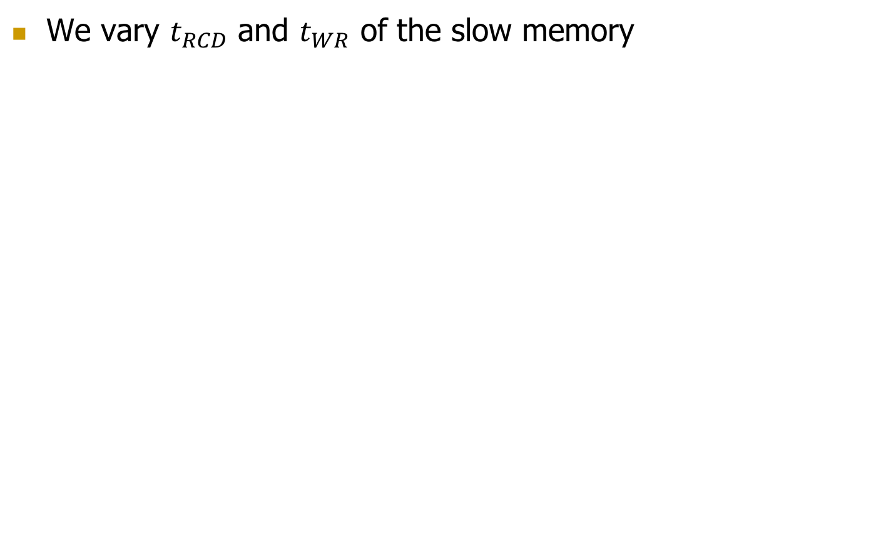
Results: Sensitivity to Slow Memory Latency
We vary $t_{RCD}$ and $t_{WR}$ of the slow memory
8%
6%
14%
13%
13%
$$t_{RCD}:$$
$$t_{WR}:$$
UH-MEM improves system performance for a wide variety of hybrid memory systems

Slide 56
More on UH-MEM
Yang Li, Saugata Ghose, Jongmoo Choi, Jin Sun, Hui Wang, and Onur Mutlu, "Utility-Based Hybrid Memory Management" Proceedings of the 19th IEEE Cluster Conference (CLUSTER), Honolulu, Hawaii, USA, September 2017. [Slides (pptx) (pdf)]

Slide 57
Challenge and Opportunity
Enabling
an Emerging Technology
to Augment DRAM
Managing Hybrid Memories

Slide 58
Another Challenge
Designing Effective
Large (DRAM) Caches

Slide 59
One Problem with Large DRAM Caches
A large DRAM cache requires a large metadata (tag + block-based information) store
How do we design an efficient DRAM cache?
CPU
LOAD X
Metadata:
X → DRAM
Mem Ctlr
Mem Ctlr
DRAM
PCM
X
(small, fast cache)
(high capacity)
Access X

Slide 60
Idea 1: Tags in Memory
Store tags in the same row as data in DRAM
Store metadata in same row as their data
Data and metadata can be accessed together
Benefit: No on-chip tag storage overhead
Downsides:
Cache hit determined only after a DRAM access
Cache hit requires two DRAM accesses
DRAM row
Cache block 0
Cache block 1
Cache block 2
Tag0
Tag1
Tag2

Slide 61
Idea 2: Cache Tags in SRAM
Recall Idea 1: Store all metadata in DRAM
To reduce metadata storage overhead
Idea 2: Cache in on-chip SRAM frequently-accessed metadata
Cache only a small amount to keep SRAM size small

Slide 62
Idea 3: Dynamic Data Transfer Granularity
Some applications benefit from caching more data
They have good spatial locality
Others do not
Large granularity wastes bandwidth and reduces cache utilization
Idea 3: Simple dynamic caching granularity policy
Cost-benefit analysis to determine best DRAM cache block size
Group main memory into sets of rows
Different sampled row sets follow different fixed caching granularities
The rest of main memory follows the best granularity
Cost–benefit analysis: access latency versus number of cachings
Performed every quantum

Slide 63
TIMBER Performance
-6%
Reduced channel contention and improved spatial locality
Meza, Chang, Yoon, Mutlu, Ranganathan, “Enabling Efficient and Scalable Hybrid Memories,” IEEE Comp. Arch. Letters, 2012.

Slide 64
TIMBER Energy Efficiency
18%
Fewer migrations reduce transmitted data and channel contention
Meza, Chang, Yoon, Mutlu, Ranganathan, “Enabling Efficient and Scalable Hybrid Memories,” IEEE Comp. Arch. Letters, 2012.

Slide 65
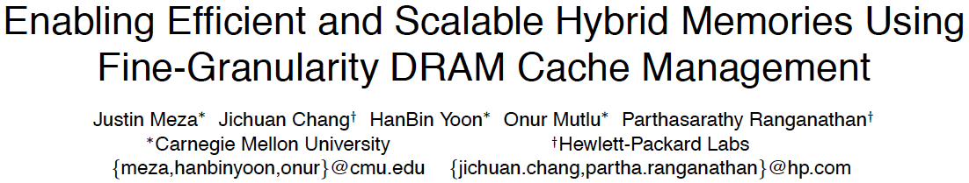
On Large DRAM Cache Design
Justin Meza, Jichuan Chang, HanBin Yoon, Onur Mutlu, and Parthasarathy Ranganathan, "Enabling Efficient and Scalable Hybrid Memories Using Fine-Granularity DRAM Cache Management" IEEE Computer Architecture Letters (CAL), February 2012.

Slide 66
DRAM Caches: Many Recent Options
Yu+, “Banshee: Bandwidth-Efficient DRAM Caching via Software/Hardware Cooperation,” MICRO 2017.

Slide 67
Banshee [MICRO 2017]
Tracks presence in cache using TLB and Page Table
No tag store needed for DRAM cache
Enabled by a new lightweight lazy TLB coherence protocol
New bandwidth-aware frequency-based replacement policy

Slide 68
More on Banshee
Xiangyao Yu, Christopher J. Hughes, Nadathur Satish, Onur Mutlu, and Srinivas Devadas, "Banshee: Bandwidth-Efficient DRAM Caching via Software/Hardware Cooperation" Proceedings of the 50th International Symposium on Microarchitecture (MICRO), Boston, MA, USA, October 2017.

Slide 69
Other Opportunities with Emerging Technologies
Merging of memory and storage
e.g., a single interface to manage all data
New applications
e.g., ultra-fast checkpoint and restore
More robust system design
e.g., reducing data loss
Processing tightly-coupled with memory
e.g., enabling efficient search and filtering

Slide 70

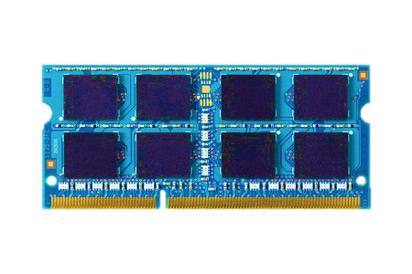
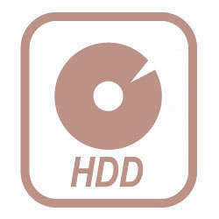
TWO-LEVEL STORAGE MODEL
CPU
Ld/St
VOLATILE
MEMORY
FAST
DRAM
BYTE ADDR
FILE
I/O
STORAGE
NONVOLATILE
SLOW
BLOCK ADDR
Notes:
If we look at our system’s today, we have a two-level storage model where memory is directly accessed by ld/st instructions, but storage is accesses by system calls. Disk stores the persistent data, but is slow and can only be accessed as a block. So we transfer data to DRAM, which is fast and byte addressable.

Slide 71
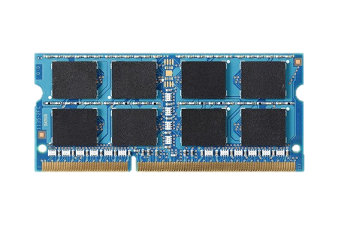
TWO-LEVEL STORAGE MODEL
CPU
Ld/St
VOLATILE
MEMORY
FAST
DRAM
BYTE ADDR
FILE
I/O
NVM
STORAGE
PCM, STT-RAM
NONVOLATILE
SLOW
BLOCK ADDR
Non-volatile memories combine characteristics of memory and storage
Notes:
However, now we have these emerging non-volatile memories which actually combine the characteristics of both memory and storage. They are fast and byte addressable like DRAM, but also can persist data as storage

Slide 72
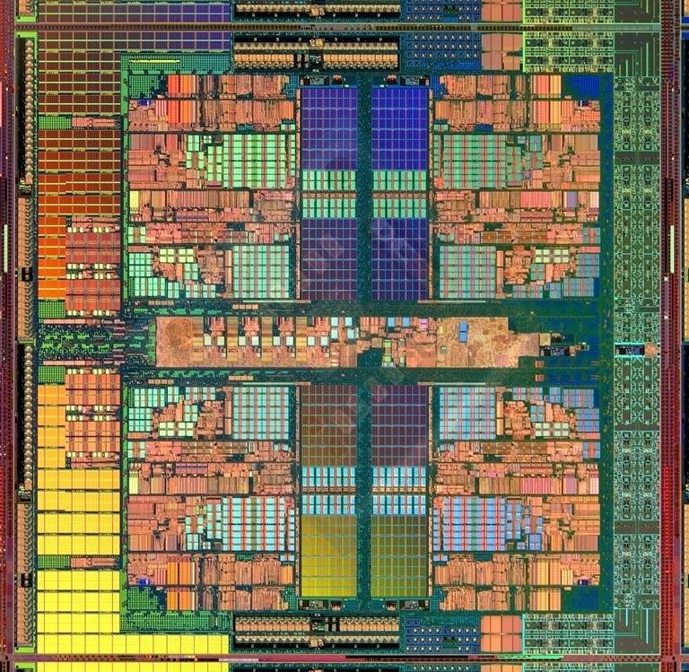
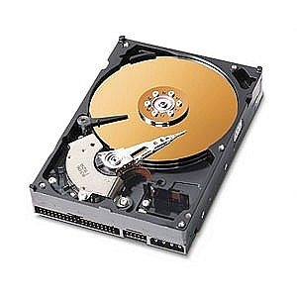
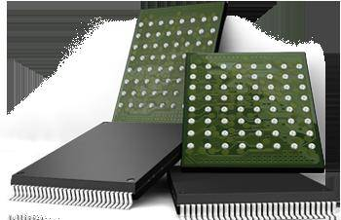
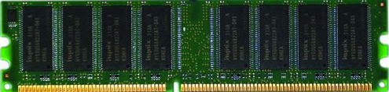
Two-Level Memory/Storage Model
The traditional two-level storage model is a bottleneck with NVM
Volatile data in memory → a load/store interface
Persistent data in storage → a file system interface
Problem: Operating system (OS) and file system (FS) code to locate, translate, buffer data become performance and energy bottlenecks with fast NVM stores
Two-Level Store
Load/Store
fopen, fread, fwrite, …
Virtual memory
Operating system
and file system
Processor
and caches
Address translation
Persistent (e.g., Phase-Change)
Memory
Main Memory
Storage (SSD/HDD)

Slide 73
Unified Memory and Storage with NVM
Goal: Unify memory and storage management in a single unit to eliminate wasted work to locate, transfer, and translate data
Improves both energy and performance
Simplifies programming model as well
Unified Memory/Storage
Persistent Memory
Manager
Processor
and caches
Load/Store
Feedback
Persistent (e.g., Phase-Change) Memory
Meza+, “A Case for Efficient Hardware-Software Cooperative Management of Storage and Memory,” WEED 2013.

Slide 74
PERSISTENT MEMORY
CPU
Ld/St
PERSISTENTMEMORY
NVM
Provides an opportunity to manipulate persistent data directly
Notes:
NVM provides an unique opportunity to manipulate persistent data directly in the main memory.

Slide 75
The Persistent Memory Manager (PMM)
Persistent objects
PMM uses access and hint information to allocate, locate, migrate and access data in the heterogeneous array of devices
Notes:
And to tie everything together, here is how a persistent memory would operate. Code allocates persistent objects and accesses them using loads and stores – no different than persistent memory in today’s machines. Optionally, the software can provide hints as to the types of access patterns or requirements of the software.
Then, a Persistent Memory Manager uses this access information and software hints to allocate, locate, migrate, and access data among the heterogeneous array of devices present on the system, attempting to strike a balance between application-level guarantees, like persistence and security, and performance and energy efficiency.

Slide 76
The Persistent Memory Manager (PMM)
Exposes a load/store interface to access persistent data
Applications can directly access persistent memory → no conversion, translation, location overhead for persistent data
Manages data placement, location, persistence, security
To get the best of multiple forms of storage
Manages metadata storage and retrieval
This can lead to overheads that need to be managed
Exposes hooks and interfaces for system software
To enable better data placement and management decisions
Meza+, “A Case for Efficient Hardware-Software Cooperative Management of Storage and Memory,” WEED 2013.
Notes:
Let’s take a closer look at the high-level design goals for a Persistent Memory Manager, or PMM.
[click] The most noticeable feature of the PMM – from the system software perspective – is the fact that it exposes a load/store interface to access all persistent data in the system. This means that applications can allocate portions of persistent memory, just as they would allocate portions of volatile DRAM memory in today’s systems.
[click] Of course, with a diverse array of devices managed by a persistent memory, it will be important for the PMM to leverage each of their strengths – and mitigate each of their weaknesses – as much as possible. To this end, the PMM is responsible for managing how volatile and persistent are placed among devices, to ensure data can be efficiently located, persistence guarantees met, and any security rules enforced.
[click] The PMM is also responsible for managing metadata storage and retrieval. We will later evaluate how such overheads affect system performance.
[click] In addition, to achieve the best performance and energy efficiency for the applications running on a system, it will be necessary for the system software to provide hints to the hardware to be used to make more efficient data placement decisions.

Slide 77
Efficient Data Mapping among Heterogeneous Devices
A persistent memory exposes a large, persistent address space
But it may use many different devices to satisfy this goal
From fast, low-capacity volatile DRAM to slow, high-capacity non-volatile HDD or Flash
And other NVM devices in between
Performance and energy can benefit from good placement of data among these devices
Utilizing the strengths of each device and avoiding their weaknesses, if possible
For example, consider two important application characteristics: locality and persistence

Slide 78
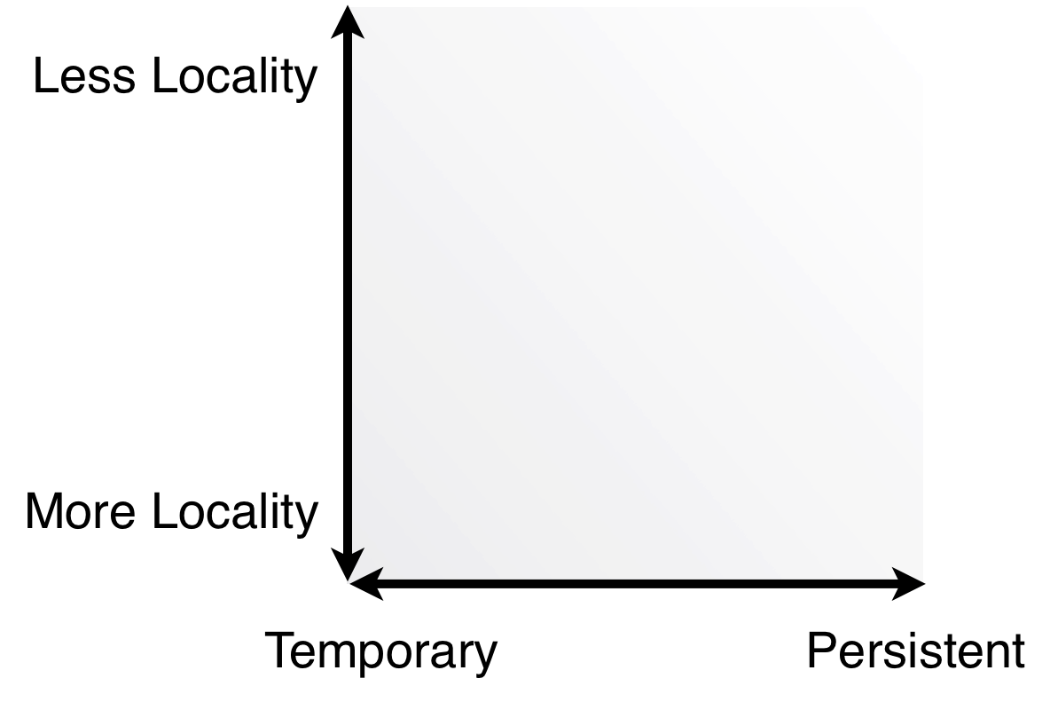
Efficient Data Mapping among Heterogeneous Devices
Notes:
Here, we’ve plotted these two important characteristics as axes on a graph. On the bottom is persistence, from temporary – the data does not need to be saved across program executions – on the left to persistent – the data must remain across executions for correct operation – on the right. From bottom to top we have data that has more locality – and is accessed very frequently in a short amount of time or space – to data that has less locality – which may predominantly be accessed in a random manner.
Let’s take a look at two examples of data and how they map onto this space.

Slide 79
Efficient Data Mapping among Heterogeneous Devices
Columns in a column store that are scanned through only infrequently
→ place on Flash
X
Notes:
First we have some data that requires high persistence but has little locality. Such data might be the columns in a column store that are only scanned through infrequently. While it is essential that this data remain persistent across runs of the program, it may not be accessed that frequently, and therefore may be more beneficial to place on slightly slower, persistent memory devices, such as Flash.

Slide 80
Efficient Data Mapping among Heterogeneous Devices
Columns in a column store that are scanned through only infrequently
→ place on Flash
X
Frequently-updated index for a Content Delivery Network (CDN) → place in DRAM
X
Applications or system software can provide hints for data placement
Notes:
On the other end of the perspective is data that has high locality but is only ephemeral and not needed between executions. Data in a Content Delivery Network that is cached as it is accessed and is constantly being updated and replaced, is a great candidate for placing in DRAM on such systems.

Slide 81
Evaluated Systems
HDD Baseline
Traditional system with volatile DRAM memory and persistent HDD storage
Overheads of operating system and file system code and buffering
NVM Baseline (NB)
Same as HDD Baseline, but HDD is replaced with NVM
Still has OS/FS overheads of the two-level storage model
Persistent Memory (PM)
Uses only NVM (no DRAM) to ensure full-system persistence
All data accessed using loads and stores
Does not waste time on system calls
Data is manipulated directly on the NVM device

Slide 82
Performance Benefits of a Single-Level Store
~24X
~5X
Meza+, “A Case for Efficient Hardware-Software Cooperative Management of Storage and Memory,” WEED 2013.

Slide 83
Energy Benefits of a Single-Level Store
~16X
~5X
Meza+, “A Case for Efficient Hardware-Software Cooperative Management of Storage and Memory,” WEED 2013.

Slide 84
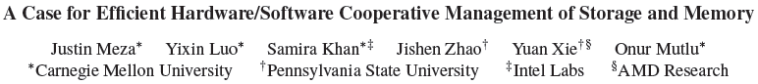
On Persistent Memory Benefits & Challenges
Justin Meza, Yixin Luo, Samira Khan, Jishen Zhao, Yuan Xie, and Onur Mutlu, "A Case for Efficient Hardware-Software Cooperative Management of Storage and Memory" Proceedings of the 5th Workshop on Energy-Efficient Design (WEED), Tel-Aviv, Israel, June 2013. Slides (pptx) Slides (pdf)

Slide 85
Challenge and Opportunity
Combined
Memory & Storage

Slide 86
Challenge and Opportunity
A Unified Interface to All Data

Slide 87
One Key Challenge in Persistent Memory
How to ensure consistency of system/data if all memory is persistent?
Two extremes
Programmer transparent: Let the system handle it
Programmer only: Let the programmer handle it
Many alternatives in-between…

Slide 88

CRASH CONSISTENCY PROBLEM
Add a node to a linked list
2. Link to prev
1. Link to next
System crash can result in
inconsistent memory state
Notes:
Let’s see an example of crash consistency problem in persistent memory systems. When we add a node in the linked list, there are two operations, first, we need to link the new node to next node and then link the previous node to the new node. Unfortunately due to the write ordering, we cannot guarantee which write will reach the memory first. If there is a power failure, depending on which write persisted, we might have a broken linked list. As a result, after a crash we can have an inconsistent memory state.

Slide 89
CURRENT SOLUTIONS
Explicit interfaces to manage consistency
NV-Heaps [ASPLOS’11], BPFS [SOSP’09], Mnemosyne [ASPLOS’11]
AtomicBegin {
Insert a new node;
} AtomicEnd;
Limits adoption of NVM
Have to rewrite code with clear partition
between volatile and non-volatile data
Burden on the programmers

Slide 90
CURRENT SOLUTIONS
Explicit interfaces to manage consistency
NV-Heaps [ASPLOS’11], BPFS [SOSP’09], Mnemosyne [ASPLOS’11]
Example Code
update a node in a persistent hash table
void hashtable_update(hashtable_t* ht,
void *key, void *data)
{
list_t* chain = get_chain(ht, key);
pair_t* pair;
pair_t updatePair;
updatePair.first = key;
pair = (pair_t*) list_find(chain,
&updatePair);
pair->second = data;
}
Notes:
Current solution propose to use explicit interfaces to protect data from inconsistency.
Let’s see a real code that updates a node in a persistent hash table.

Slide 91
CURRENT SOLUTIONS
void TMhashtable_update(TMARCGDECL
hashtable_t* ht, void *key, void*data){
list_t* chain = get_chain(ht, key);
pair_t* pair;
pair_t updatePair;
updatePair.first = key;
pair = (pair_t*) TMLIST_FIND(chain,
&updatePair);
pair->second = data;
}
Notes:
The code looks like this after we use the transactional interface. However, there are several issues in the code.

Slide 92
CURRENT SOLUTIONS
Manual declaration of persistent components
void TMhashtable_update(TMARCGDECL
hashtable_t* ht, void *key, void*data){
list_t* chain = get_chain(ht, key);
pair_t* pair;
pair_t updatePair;
updatePair.first = key;
pair = (pair_t*) TMLIST_FIND(chain,
&updatePair);
pair->second = data;
}
Notes:
First, the programmer has to manually declare the persistent object.

Slide 93
CURRENT SOLUTIONS
Manual declaration of persistent components
void TMhashtable_update(TMARCGDECL
hashtable_t* ht, void *key, void*data){
list_t* chain = get_chain(ht, key);
pair_t* pair;
pair_t updatePair;
updatePair.first = key;
pair = (pair_t*) TMLIST_FIND(chain,
&updatePair);
pair->second = data;
}
Need a new implementation
Notes:
Second, the programmers need to rewrite the functions so that they correctly manipulate the persistent data

Slide 94
CURRENT SOLUTIONS
Manual declaration of persistent components
void TMhashtable_update(TMARCGDECL
hashtable_t* ht, void *key, void*data){
list_t* chain = get_chain(ht, key);
pair_t* pair;
pair_t updatePair;
updatePair.first = key;
pair = (pair_t*) TMLIST_FIND(chain,
&updatePair);
pair->second = data;
}
Need a new implementation
Third party code
can be inconsistent
Notes:
Third, third party code needs to be consistent

Slide 95
CURRENT SOLUTIONS
Manual declaration of persistent components
void TMhashtable_update(TMARCGDECL
hashtable_t* ht, void *key, void*data){
list_t* chain = get_chain(ht, key);
pair_t* pair;
pair_t updatePair;
updatePair.first = key;
pair = (pair_t*) TMLIST_FIND(chain,
&updatePair);
pair->second = data;
}
Need a new implementation
Prohibited
Operation
Third party code
can be inconsistent
Burden on the programmers
Notes:
Programmers need to make sure there is no volatile to non-volatile pointers. Clearly writing code for persistent memory is a burden on the general programmers.

Slide 96
OUR APPROACH: ThyNVM
Goal:
Software transparent consistency in
persistent memory systems
Key Idea:
Periodically checkpoint state;
recover to previous checkpt on crash

Slide 97
ThyNVM: Summary
A new hardware-based
checkpointing mechanism
Checkpoints at multiple granularities to reduce both checkpointing latency and metadata overhead
Overlaps checkpointing and execution to reduce checkpointing latency
Adapts to DRAM and NVM characteristics
Performs within 4.9% of an idealized DRAM with zero cost consistency

Slide 98
2. OVERLAPPING CHECKPOINTING AND EXECUTION
time
Running
Checkpointing
Running
Checkpointing
Epoch 0
Epoch 1
Epoch 0
Epoch 1
time
Running
Checkpointing
Running
Checkpointing
Running
Checkpointing
Epoch 0
Epoch 1
Epoch 2
Notes:
Even with the dual granularity checkpointing, checkpointing latency is dominated by the slow DRAM write back. In order to reduce the latency we propose to overlap checkpointing with execution. Instead of stalling when DRAM pages are getting written back to memory, we let the application start the next epoch. This hides the long latency of page writeback scheme.

Slide 99
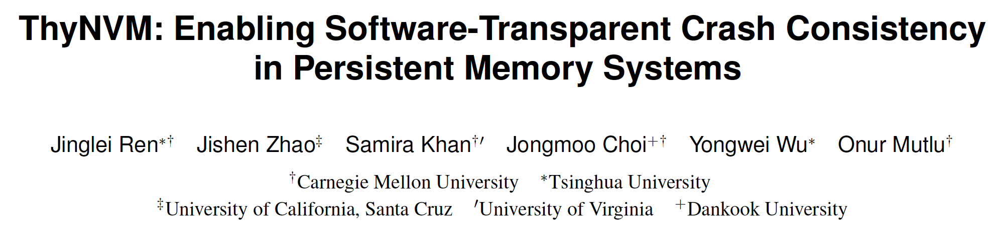
More About ThyNVM
Jinglei Ren, Jishen Zhao, Samira Khan, Jongmoo Choi, Yongwei Wu, and Onur Mutlu, "ThyNVM: Enabling Software-Transparent Crash Consistency in Persistent Memory Systems" Proceedings of the 48th International Symposium on Microarchitecture (MICRO), Waikiki, Hawaii, USA, December 2015. [Slides (pptx) (pdf)] [Lightning Session Slides (pptx) (pdf)] [Poster (pptx) (pdf)] [Source Code]

Slide 100
Another Key Challenge in Persistent Memory
Programming Ease
to Exploit Persistence

Slide 101
Tools/Libraries to Help Programmers
Himanshu Chauhan, Irina Calciu, Vijay Chidambaram, Eric Schkufza, Onur Mutlu, and Pratap Subrahmanyam, "NVMove: Helping Programmers Move to Byte-Based Persistence" Proceedings of the 4th Workshop on Interactions of NVM/Flash with Operating Systems and Workloads (INFLOW), Savannah, GA, USA, November 2016. [Slides (pptx) (pdf)]

Slide 102
The Future of Emerging Technologies is Bright
Regardless of challenges
in underlying technology and overlying problems/requirements
Problem
Can enable:
- Orders of magnitude
improvements
- New applications and
computing systems
Yet, we have to
- Think across the stack
- Design enabling systems
Algorithm
Program/Language
System Software
SW/HW Interface
Micro-architecture
Logic
Devices
Electrons

Slide 103
If In Doubt, Refer to Flash Memory
A very “doubtful” emerging technology
for at least two decades
Proceedings of the IEEE, Sept. 2017
https://arxiv.org/pdf/1706.08642

Slide 104
Memory Systems Fundamentals, Recent Research, Challenges, Opportunities Lecture 5: Emerging Memory Technologies
Prof. Onur Mutlu
omutlu@gmail.com
https://people.inf.ethz.ch/omutlu
9 October 2018
Technion Fast Course 2018

